Slide 1

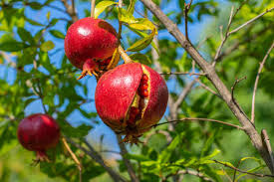
From Shallow CNNs to Object Detection: YOLOv5 Sets a New Standard for Fruit Disease Classification
Presented by :
Mentors :
Madhav Gaba
Shorya Gupta
Aman
Dr. Raman Goyal
(CSED Department)
Group No : 34(b)

Slide 2

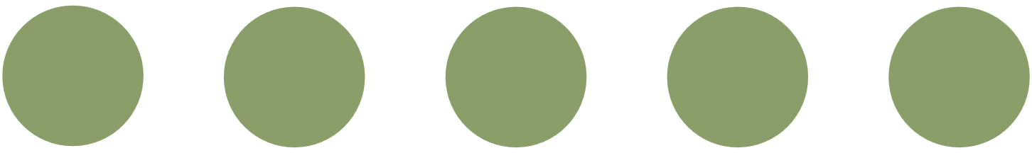
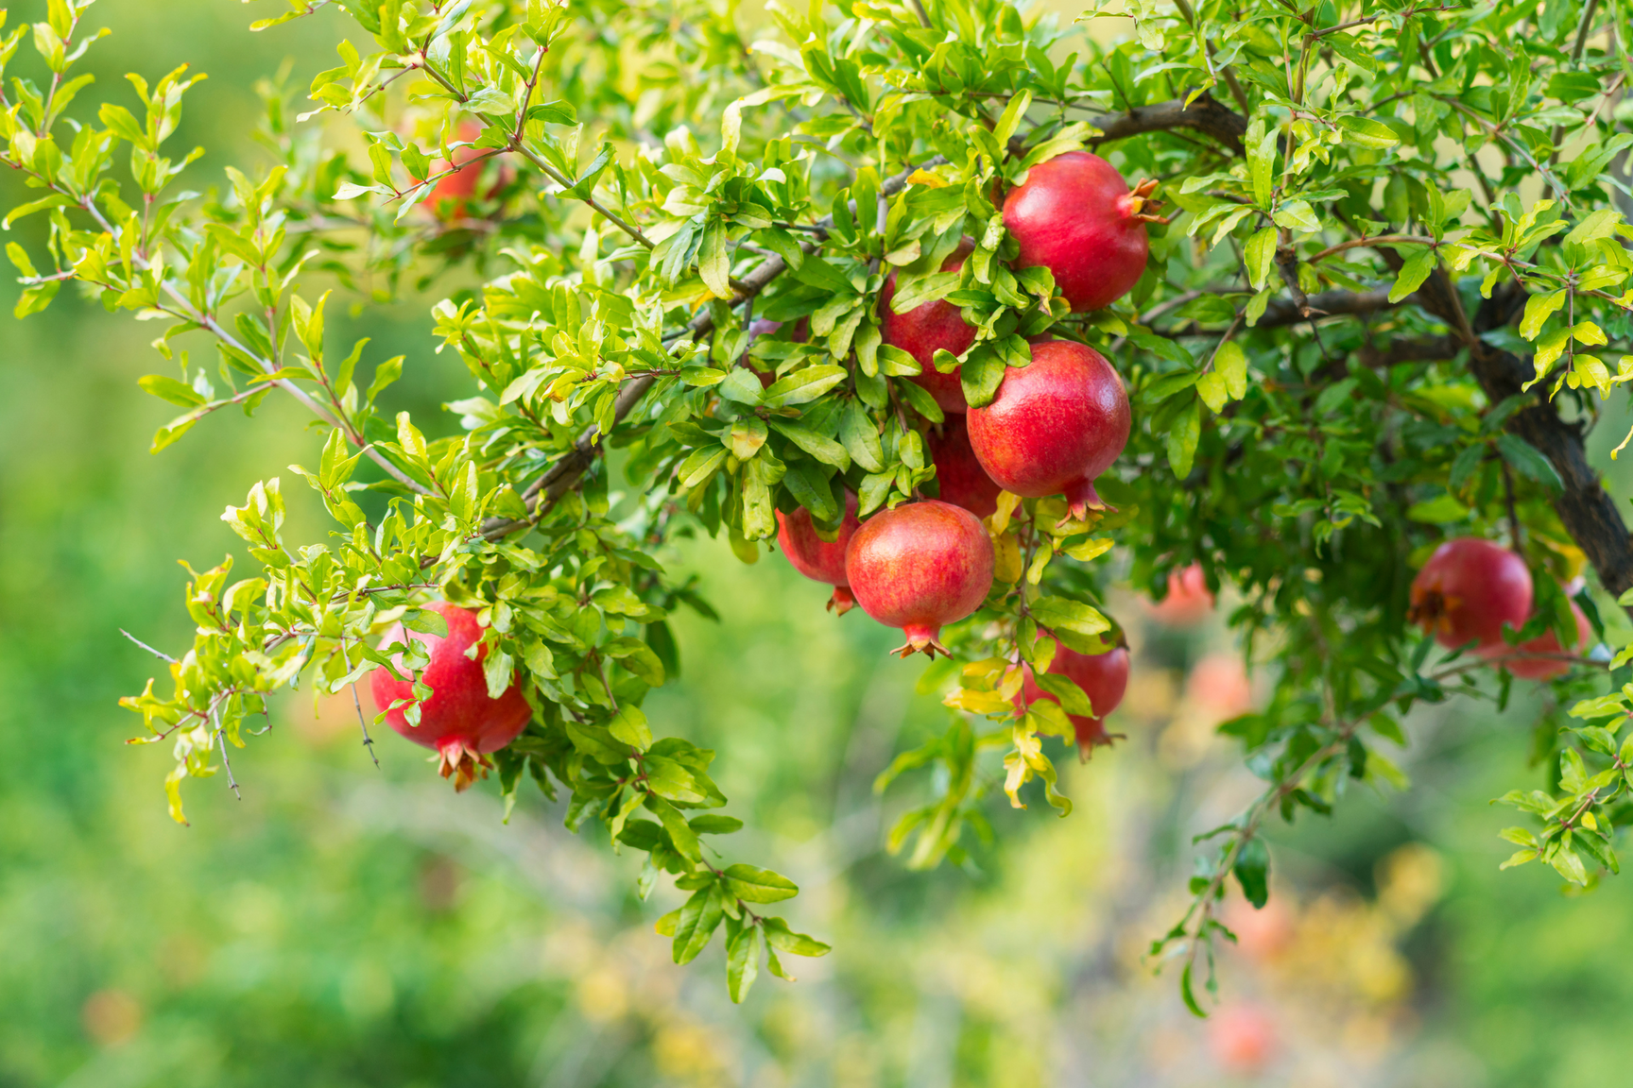

INTRODUCTION
Pomegranate crops are highly vulnerable to a variety of leaf diseases, making early detection essential for minimizing yield losses and ensuring crop quality. This project explores a deep learning-based approach for automated pomegranate disease classification and detection using four different models: a baseline CNN, PDD-TLDCNN (a transfer learning–driven hybrid model), SIFFD-DSGAN (a shallow image feature fusion discriminator with data synthesis), and YOLOv5 (a lightweight object detection model).
A custom dataset of pomegranate leaf images across five disease categories was used for training and evaluation. Dummy bounding boxes were employed to adapt the dataset for object detection with YOLOv5, effectively transforming the task from classification to detection.

Slide 3

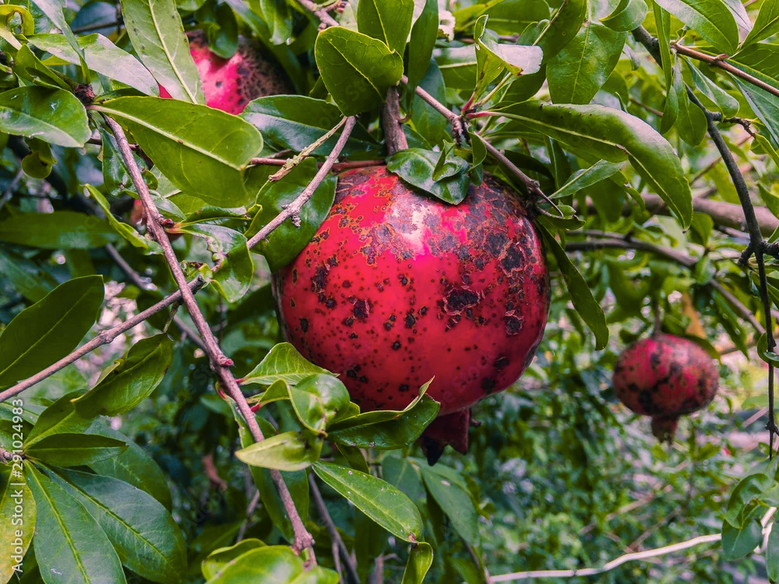
PROBLEM OVERVIEW
Pomegranate is a high-value fruit crop and a key contributor to India’s horticultural exports. However, it is highly susceptible to fungal and bacterial diseases, particularly during the monsoon and humid seasons. A major challenge is that these diseases often remain undetected until visible symptoms emerge—by which time the infection may have already spread extensively, causing substantial crop loss and reduced market value.
Currently, disease identification is largely dependent on manual visual inspection and reactive treatment, which is often too late to be effective. Small and marginal farmers, in particular, lack access to expert agronomists, diagnostic labs, or advanced cloud-based diagnostic tools. This highlights a critical gap in the agricultural landscape: the need for an accessible, cost-effective, and automated solution that enables early detection of pomegranate diseases using image-based analysis.

Slide 4



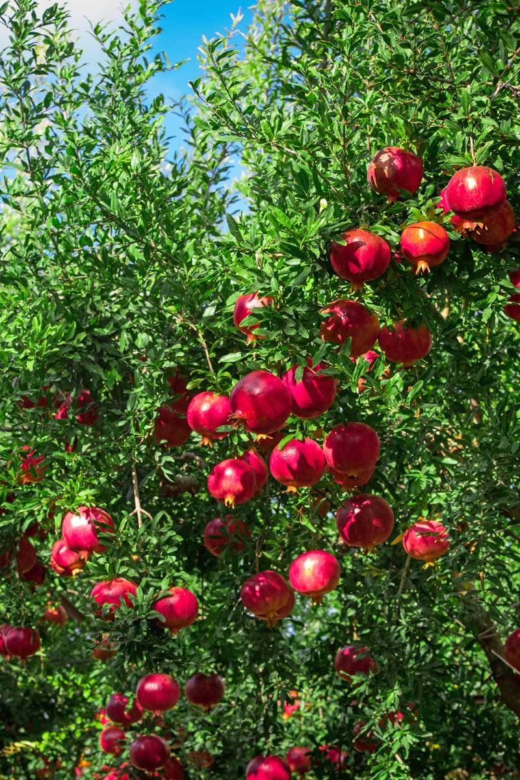
OBJECTIVES
The objective of this project is to design, implement, and evaluate a deep learning–based system for the early and automated detection of pomegranate leaf diseases. We explore and compare the performance of four different deep neural network architectures: SIFFD-DSGAN (Scale-Invariant Feature Fusion Dense Deep Neural Network with Data Synthesis using GANs), EFDDNN-EI (Enhanced Fruit Disease Detection Neural Network with Environmental Integration), PDD-TLDCNN (Pomegranate Disease Detection using a Transfer Learning–Driven Dilated and Dense Convolutional Neural Network), and YOLOv5, a state-of-the-art object detection model. Among these, YOLOv5 achieved the highest classification accuracy and fastest inference, making it the most suitable candidate for real-time deployment in precision agriculture applications.
Benchmark four models on custom dataset to identify the most accurate disease detection approach.
Assess each model’s performance in terms of classification accuracy, speed, and deployment readiness.
Select YOLOv5 as the optimal model for scalable, fast, and reliable disease identification.

Slide 5
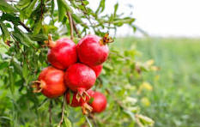
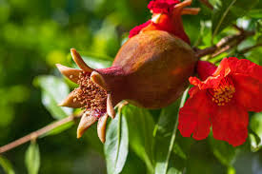
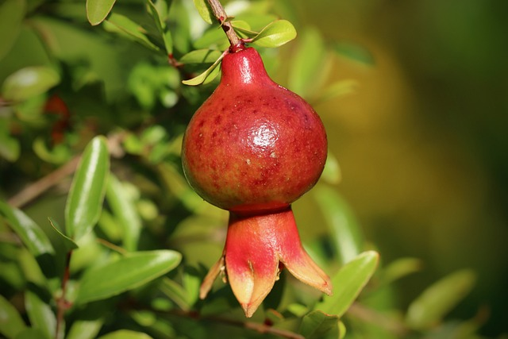
CHALLENGES FACED
Mismatch in label quality
Image Quality issue
Overfitting due to small
dataset
GPU memory limits on
Colab
Need for robust
validation
Class Imbalance

Slide 6
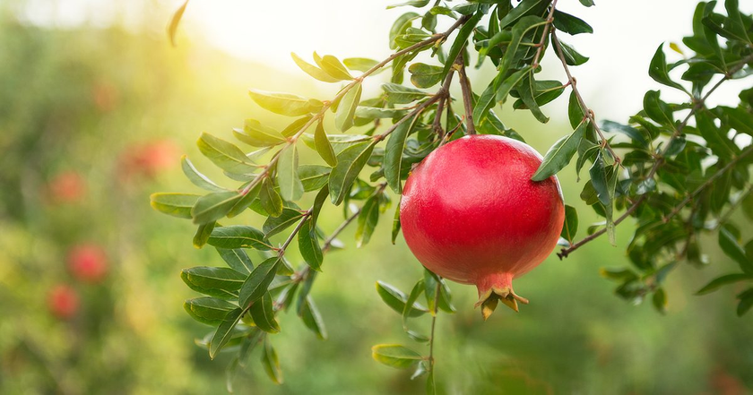
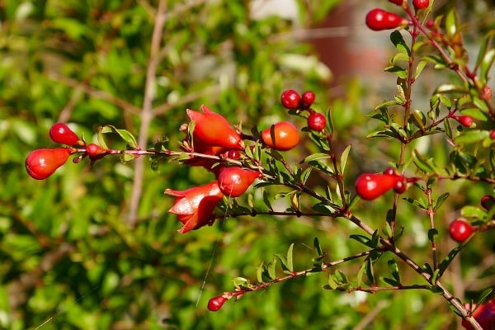
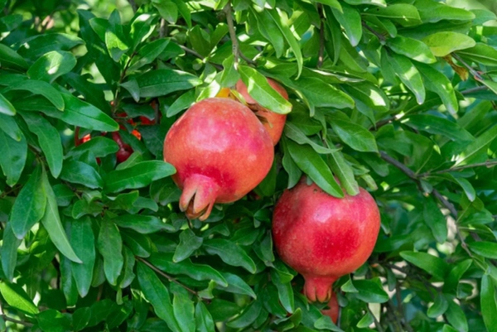
OUR DATASET
Pomegranate Disease Dataset Summary:
Images: 3,228 total images
Classes: 5 classes (Alternaria, Anthracnose, Bacterial Blight, Cercospora, Healthy)
Data Type: RGB images (leaf-level)
Source: Collected from real farm environments
Annotation: Dummy bounding boxes for detection-based training
Format: JPEG images with labeled folders (one per class)
Image Dimensions: Varying resolutions (resized during preprocessing)
Dataset Link: https://www.kaggle.com/datasets/aman0515643/pomegranate-disease

Slide 7
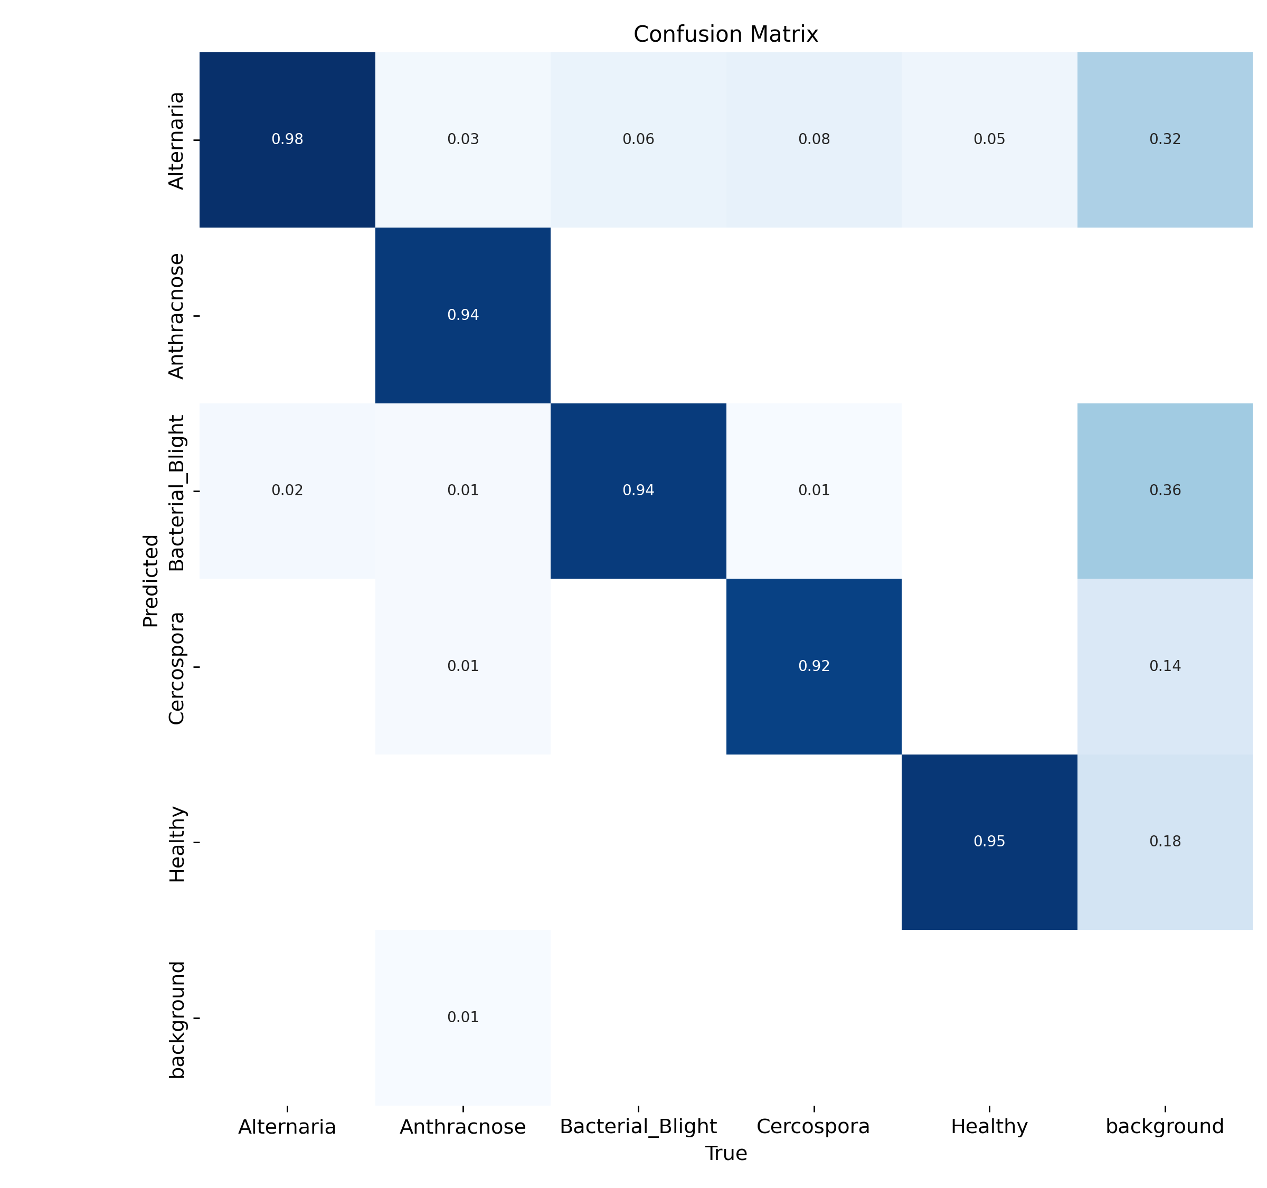
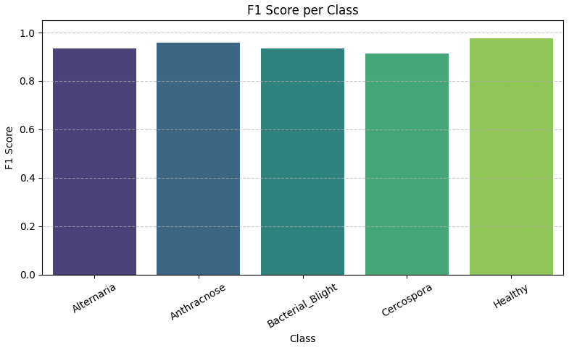
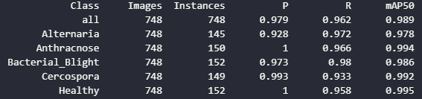
YOLOv5(Accuracy:98.9%)
Annotated dataset (dummy bounding boxes)
Custom training with 5-class model
Fastest inference among all models
Real-time object detection and classification
Result: Best performance — ideal for real-world deployment

Slide 8
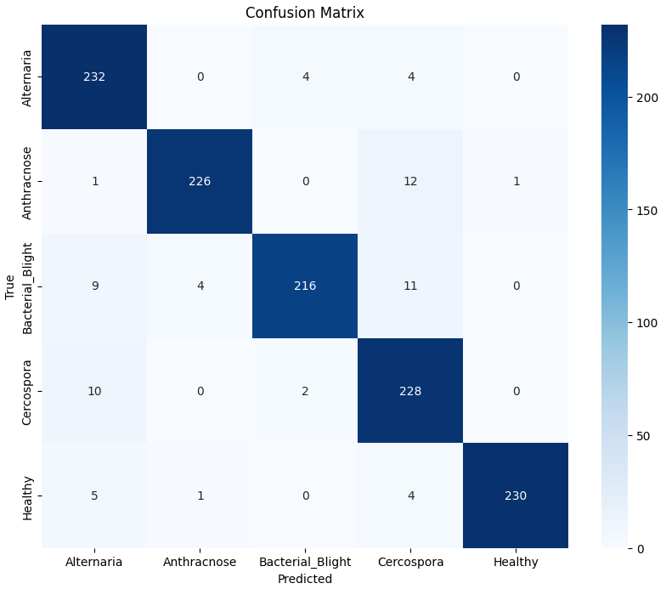
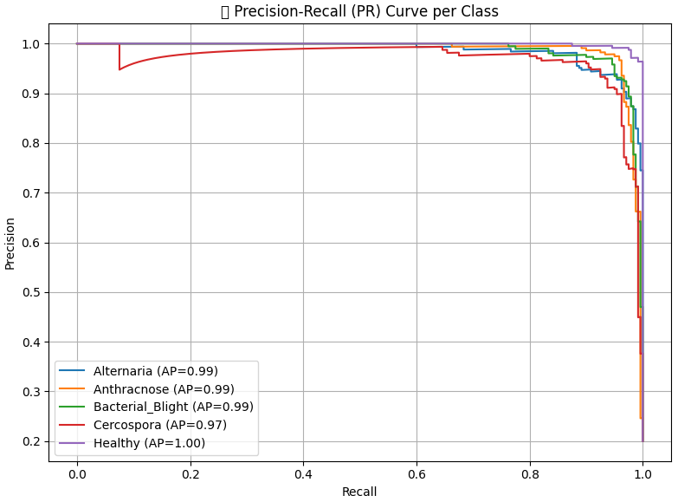
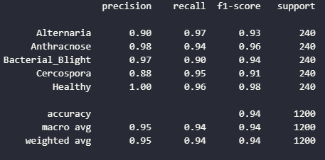
SPDD-TLDCNN(Accuracy:94.33%)
Transfer learning (MobileNetV2)
Dilated convolutions for spatial context
Dense connectivity for deep feature reuse
Extensive data augmentation
Result: Strong balance of accuracy and generalization

Slide 9
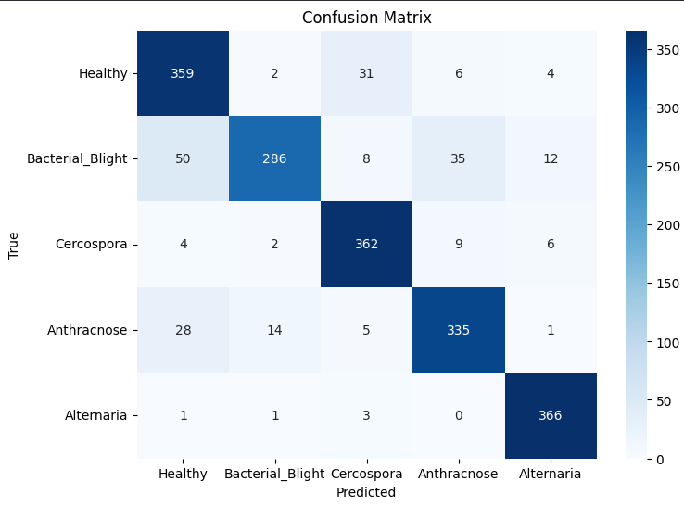
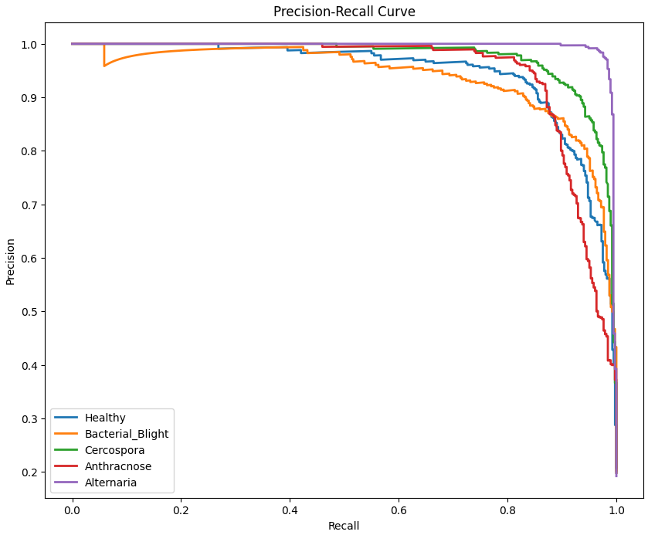
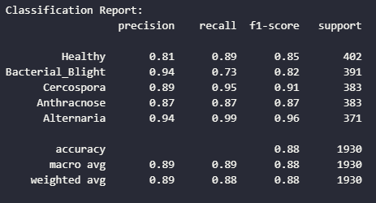
EFDDNN-EI(Accuracy:88.50%)
Dataset preprocessing & augmentation
Environmental data (dummy integration)
Deep CNN with dropout & batch normalization
Multiple dense layers for robust classification
Result: Good performance with integrated environmental features

Slide 10
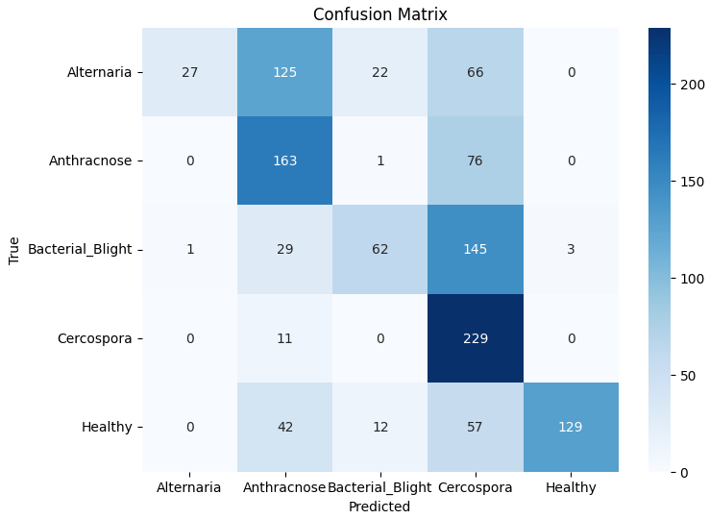
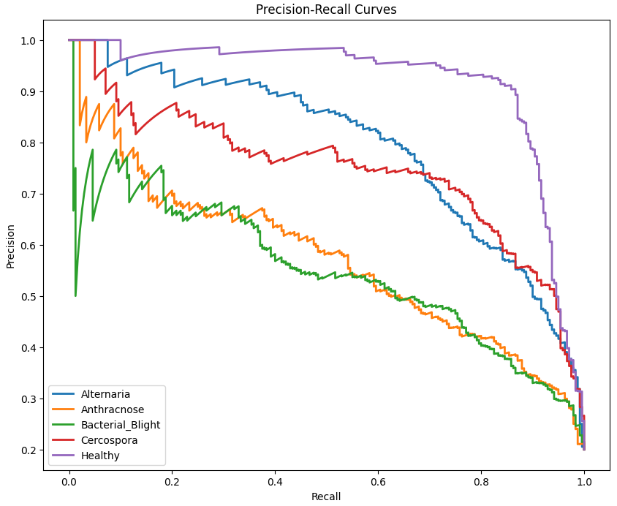
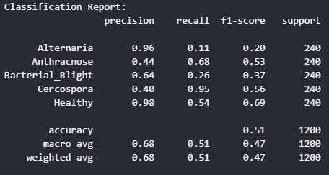
SIFFD-DSGAN(Accuracy:50.83%)
Data split with splitfolders
Synthetic data generation using GANs
Custom CNN with scale-invariant dense fusion layers
Trained using Adam optimizer with callbacks
Result: Low accuracy due to class imbalance and overfitting

Slide 11
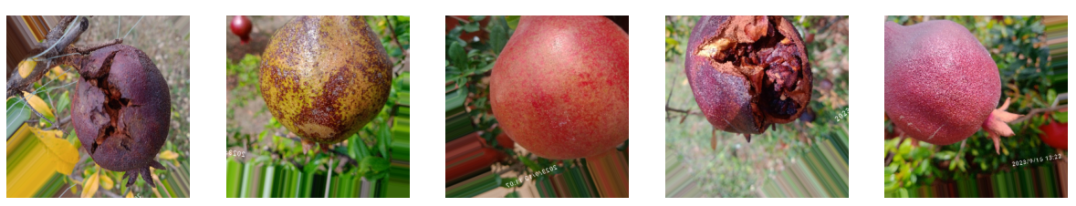
CONCLUSION
Among the four models evaluated — SIFFD-DSGAN (50.83%), EFDDNN-EI (88.50%), PDD-TLDCNN (94.33%), and YOLOv5 (97.91%) — YOLOv5 proved the most effective for pomegranate disease detection.
Unlike classification models that lack spatial awareness, YOLOv5 treats the task as object detection, enabling it to localize diseased regions, handle multiple infections, and achieve faster, real-time inference.
Despite using dummy annotations, it learned strong spatial features, delivering the highest accuracy. Its scalability, precision, and deployment readiness make YOLOv5 the best fit for real-time agricultural applications.

Slide 12
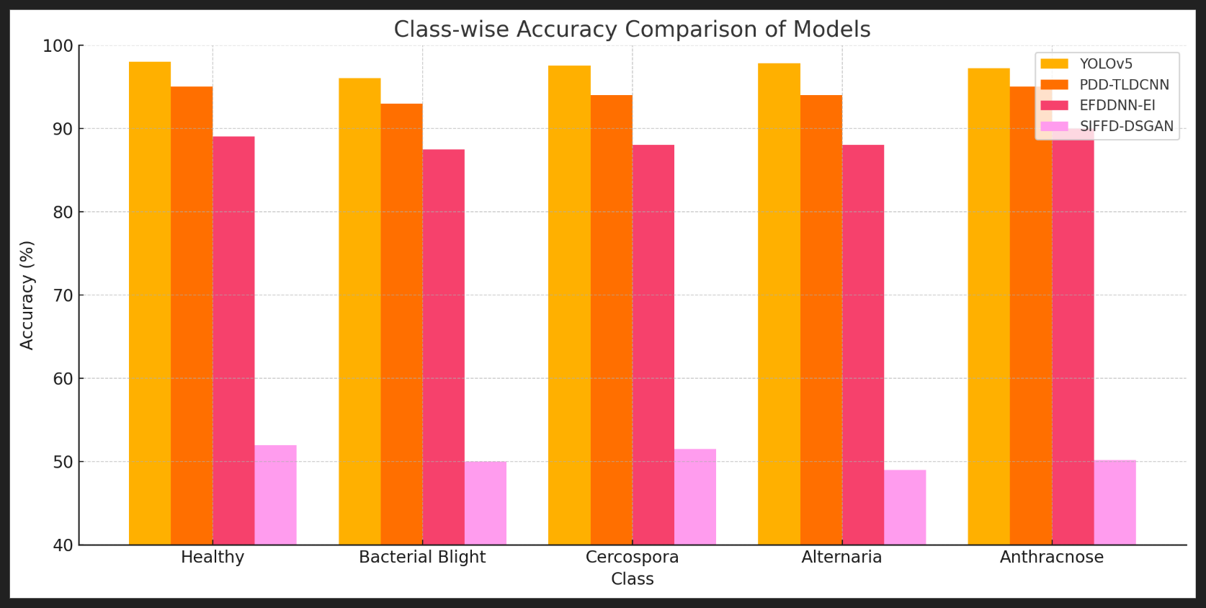
Class-Wise Accuracy Comparison of Models

Slide 13
REFERENCES
https://www.sciencedirect.com/science/article/pii/S0957417425021785
https://www.kaggle.com/datasets/aman0515643/pomegranate-disease
https://wandb.ai/anonymousking23301-thapar-university/YOLOv5?nw=nwuseranonymousking23301
https://ieeexplore.ieee.org/document/9781688
https://ieeexplore.ieee.org/document/9358541

Slide 14
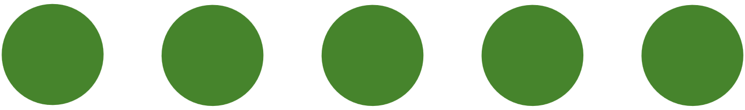
THANK YOU

